Slide 1

Web Security

Slide 2
Quality of Web App?
Functional Requirements Implemented and tested requirements
Non Functional Requirements Load
Scalability
Performance Documentation Recovery SECURITY

Slide 3
What is Web Security ?
Web application security, is a branch of Information Security that deals specifically with security of websites, web applications and web services. At a high level, Web application security draws on the principles of application security but applies them specifically to Internet and Web systems.
What can Web Users do ?
The first step in protecting yourself is to recognize the risks and become familiar with some of the terminology associated
with them.

Slide 4
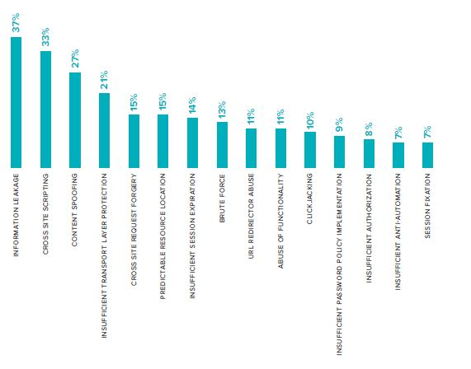
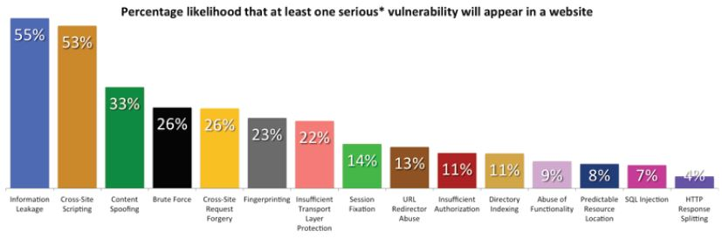
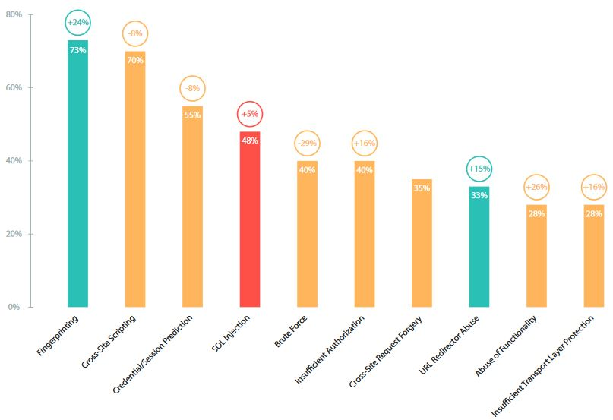
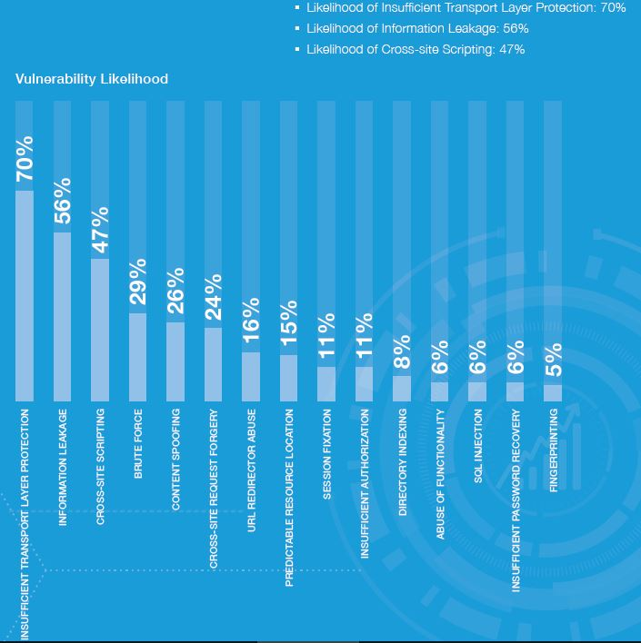
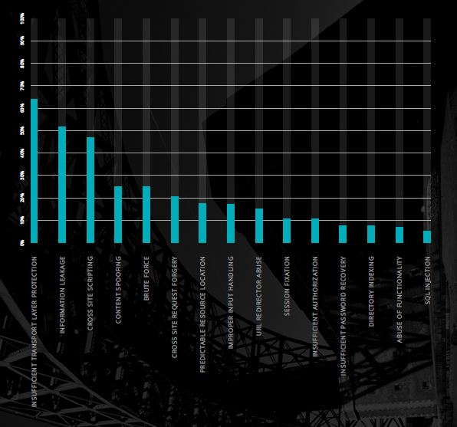
Statistics of Security Risks

Slide 5
Commonly Used Attacking Techniques :
Cross Site Scripting
Brute Force
SQL Injection
Session Hijacking
Parameter tampering
DOS (Denial Of Services)
Information Leakage
Insufficient Transport Layer Protection
Insufficient authorization

Slide 6
Cross Site Scripting or XSS
Cross-Site Scripting (XSS) attacks are a type of injection, in which malicious scripts are injected into otherwise benign and trusted web sites. XSS attacks occur when an attacker uses a web application to send malicious code, generally in the form of a browser side script, to a different end user. The malicious script can access any cookies, session tokens, or other sensitive information retained by the browser and used with that site. These scripts can even rewrite the content of the HTML page

Slide 7
Cross Site Scripting or XSS
Cross-Site Scripting (XSS) attacks are a type of injection, in which malicious scripts are injected into otherwise benign and trusted web sites. XSS attacks occur when an attacker uses a web application to send malicious code, generally in the form of a browser side script, to a different end user. The malicious script can access any cookies, session tokens, or other sensitive information retained by the browser and used with that site. These scripts can even rewrite the content of the HTML page

Slide 8
XSS | Remedy
Escaping Escape any and all HTML, URL, and JavaScript entities Validating Input Ensuring an application is rendering the correct data and Preventing malicious data from doing harm to the site, database, and users Sanitizing Changing unacceptable user input to an acceptable format.

Slide 9
Brute Force
Used for guessing passwords and bypassing access control.
Types: Dictionary Attack Hybrid Attack Rainbow Table Search Attack

Slide 10
Brute | Remedy
Use Captchas It enables to distinguish between a machine and human. IP Lockout Lock out the IP with multiple login failures. Delays
Allow Random delays between login trials.

Slide 11
SQL Injection or SQLi
Enter carefully crafted data that causes the input to be interpreted as part of a SQL query instead of data.
Consequences of a SQL injection attack could be:
Loss of data confidentiality
Loss of data integrity
Loss of data
Compromise of the entire network

Slide 12
SQLi | Remedy
Don't use dynamic SQL when it can be avoided: used prepared statements, parameterized queries or stored procedures instead whenever possible. Use appropriate privileges: Using a limited access account is far safer, and can limit what a hacker is able to do. Escape/Quotesafe the input (string quoting/parsing)

Slide 13
The Denial of Service (DoS) attack
Making a resource (site, application, server) unavailable for the purpose it was designed. If a service receives a very large number of requests, it may cease to be available to legitimate users. Programming vulnerability is exploited. DoS DDoS Reflected DoS

Slide 14
DoS Attack | Remedies

Slide 15
Session Hijacking
Taking control of a user session after successfully obtaining or generating an authentication session ID. Exploit the vulnerability of a system which allows one person to fixate (set) another person's session identifier (SID). Using Packet Sniffers Spoofing

Slide 16
Session Hijacking | Remedy
Regenerate session ID after a successful login Validate user specific data (Agent, IP, HTTP-X-Forwarded-For etc)

Slide 17
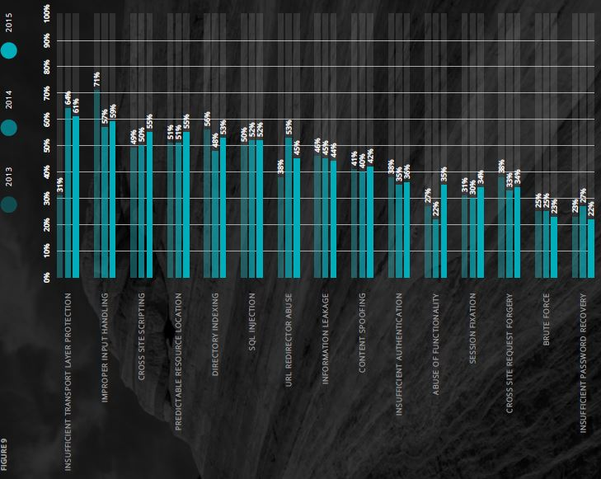
Remediation
Remediation rates have been improving
only very incrementally for the majority of the vulnerability classes.

Slide 20
Thank You ☺
Submitted To :
Dr. Anu Gupta
Submitted By :
Akshay Kapoor (04) Sukhpreet Singh (33)

